Slide 1
Speciation
Macroevolution
Allopatric
Sympatric

Slide 2
Evolution
Mutation
Non-random changes to allele frequency of population
Random changes to allele frequency of population
Variation in Gene Pool
Variation in Populations
Natural Selection
Sexual Selection
Artificial Selection (Selective breeding)
Genetic Drift
Bottleneck Effect
Founder Effect
Mechanisms of Evolution
Microevolution
Gene Flow

Slide 3
Evolution
1. Mutation
2. Natural Selection
3. Genetic Drift
Mechanisms of Evolution
4. Gene Flow
Microevolution
Long time period (many generations)
Speciation
Macroevolution

Slide 4
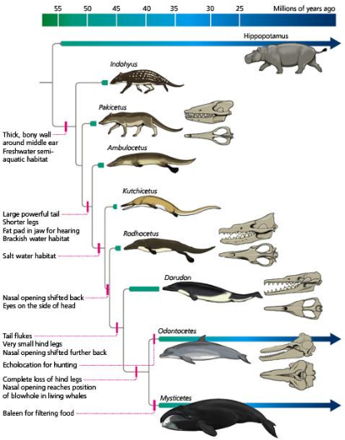
Syllabus:
Heredity
Essential
Question:
BIOLOGY WA UNITS 3&4
Chapter 9 Mechanisms of Evolution and Speciation pg. 310 - 316
Questions
Set 9.7 pg. 316
BIOZONE Activity Number:
245 – Speciation
232 & 233 – Allopatric Speciation
234, 235 & 236 – Isolating Mechanisms
237 – Sympatric Speciation
Topic Question 1:
Define Macroevolution

Slide 5
Biological species concept
SPECIES
Phylogenetic species concept
SPECIATION
REPRODUCTIVE ISOLATION
PRE-REPRODUCTIVE ISOLATION
POST REPRODUCTIVE ISOLATION
TYPES OF SPECIATION

Slide 6
Practice Questions

Slide 7
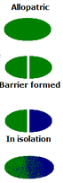
Topic Question 3:
Describe the process of Allopatric Speciation

Slide 8
Sum it up!
Draw a Concept map or mind map of evolution and Speciation, making links to heredity to summarise what you have learnt

Slide 9
Practice Questions
Question 37 (2017 Exam)
Describe the process of allopatric speciation. (10 marks)

Slide 10
Practice Questions
Question 37 (2020 Exam)
There are more species of rock wallaby than of any other type of wallaby or kangaroo. Rock wallabies live in small populations on isolated rocky outcrops in a range of environments across Australia. Interactions between populations on different outcrops are non-existent or very rare.
Explain why there are so many species of rock wallaby. (10 marks)

